Slide 1
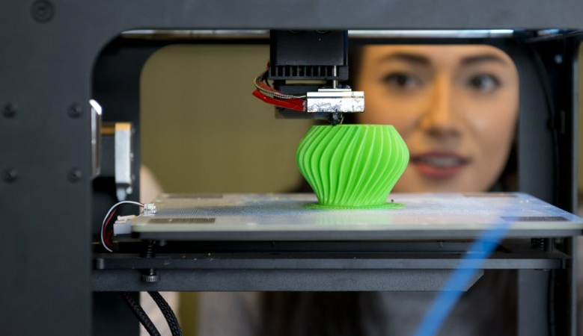

What is Manufacturing?
Clemson University
CENTER FOR ADVANCED MANUFACTURING

Slide 2
What is Manufacturing?
Manufacturing is the making of goods by hand or by machine for sale to a customer.

Slide 3
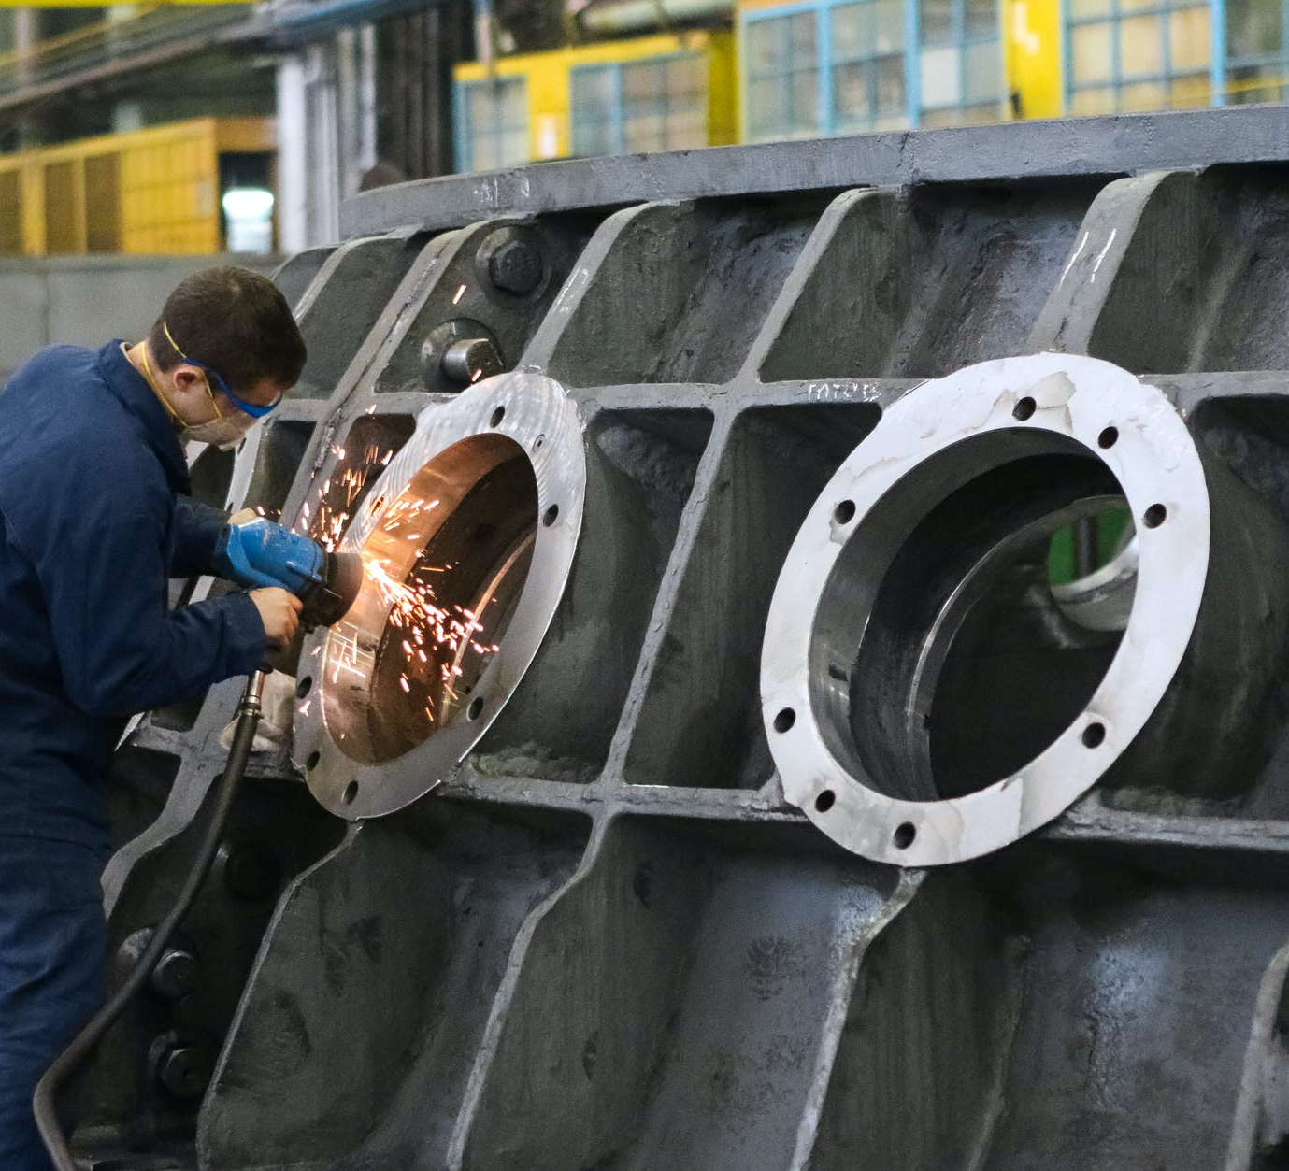
… usually takes place in a plant or factory.
Manufacturing…

Slide 4
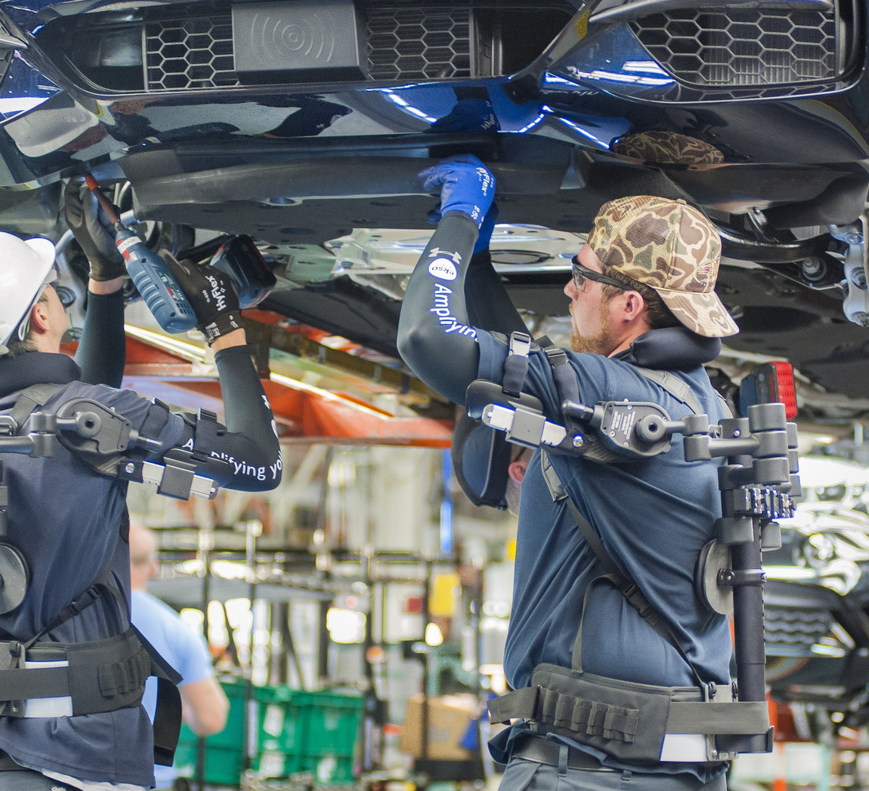
Manufacturing…
… uses people and machines to make finished products.

Slide 5
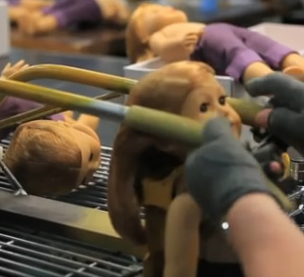
… focuses on producing large numbers of a product.
Manufacturing…

Slide 6
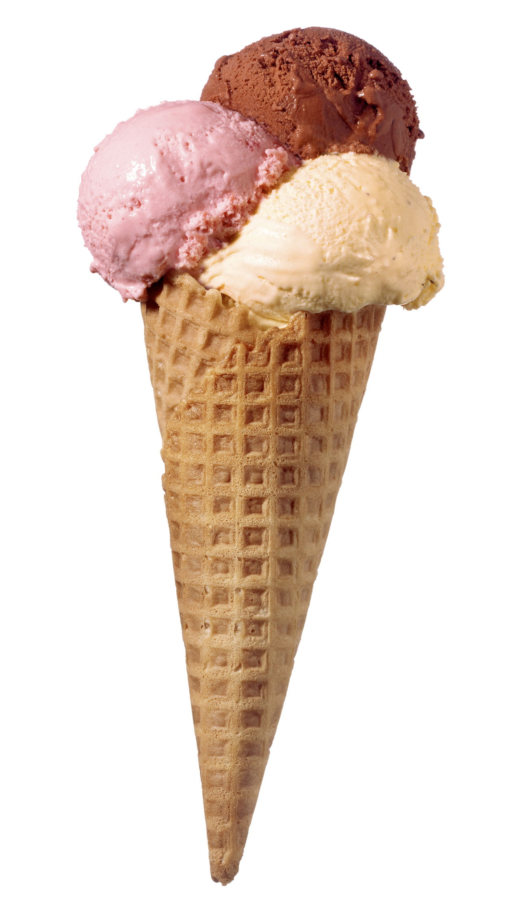
HOW WOULD YOU MANUFACTURE 100 ICE CREAM CONES?

Slide 7
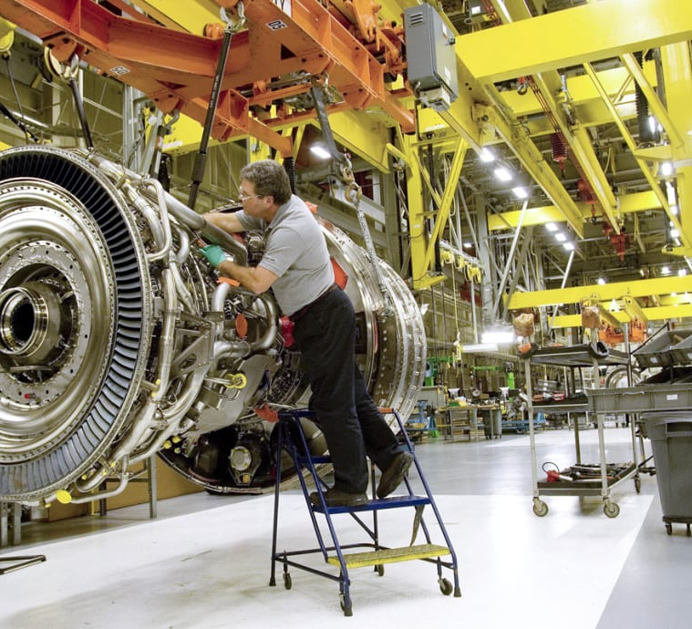
What DO Manufacturing jobs look like today?
Notes:
MANUFACTURING JOBS
Assembly
Equipment Operator
Maintenance
Engineers
Scientists
Accountants
Teachers
--
SKILLS
- Machinery operation
- CNC programming, CAD
- Computer use
- Teamwork and communication
…

Slide 8
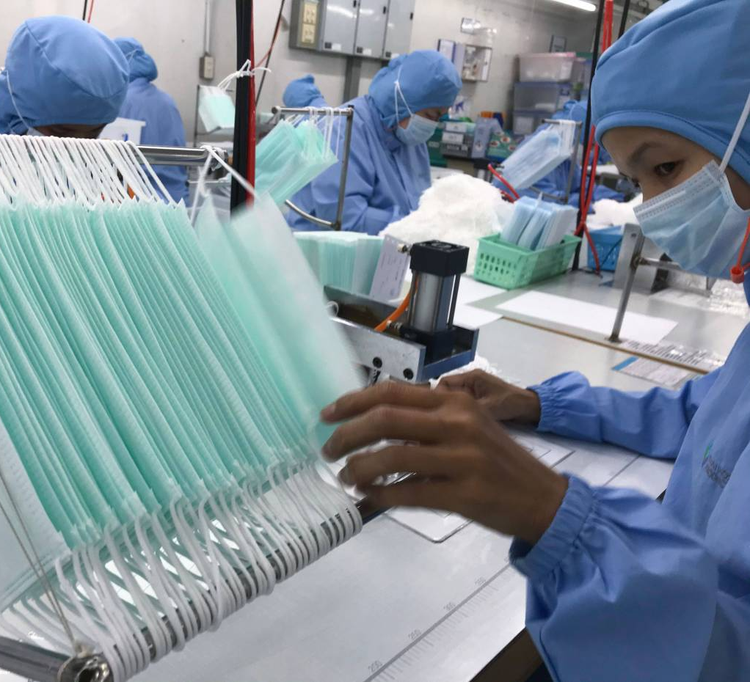
What DO Manufacturing jobs look like today?

Slide 9
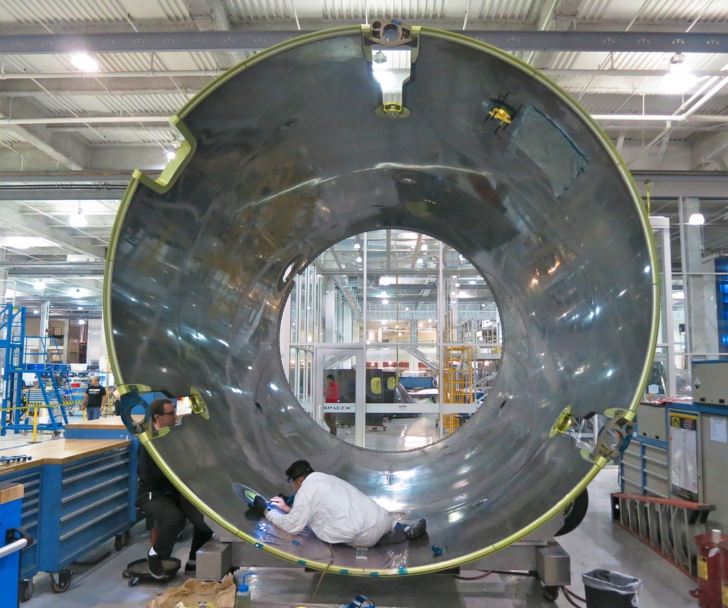
What DO Manufacturing jobs look like today?

Slide 10
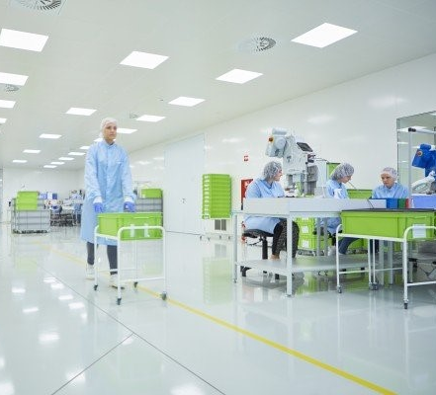
What DO Manufacturing jobs look like today?

Slide 11
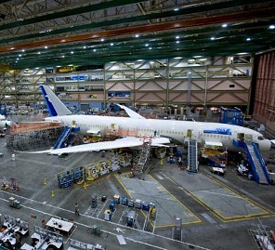
What DO Manufacturing jobs look like today?

Slide 12
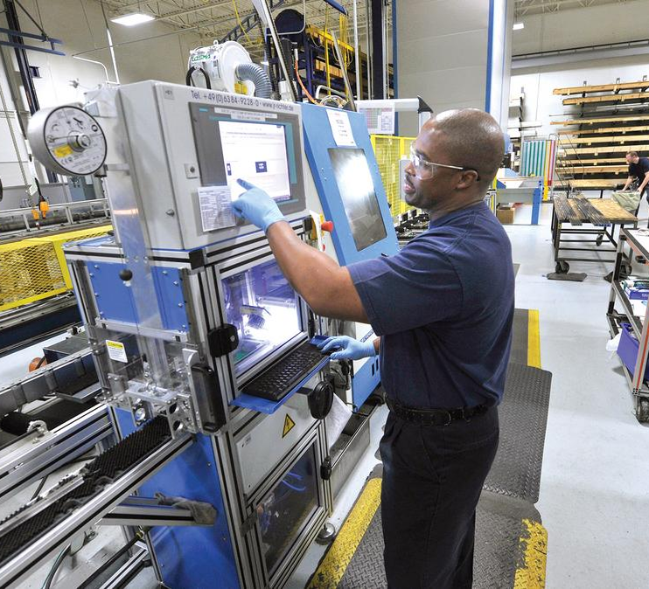
What Challenges do manufacturing workers face?
Notes:
https://media.bizj.us/view/img/2122221/bosch-rexroth-2*1200xx2100-1181-0-108.jpg

Slide 13
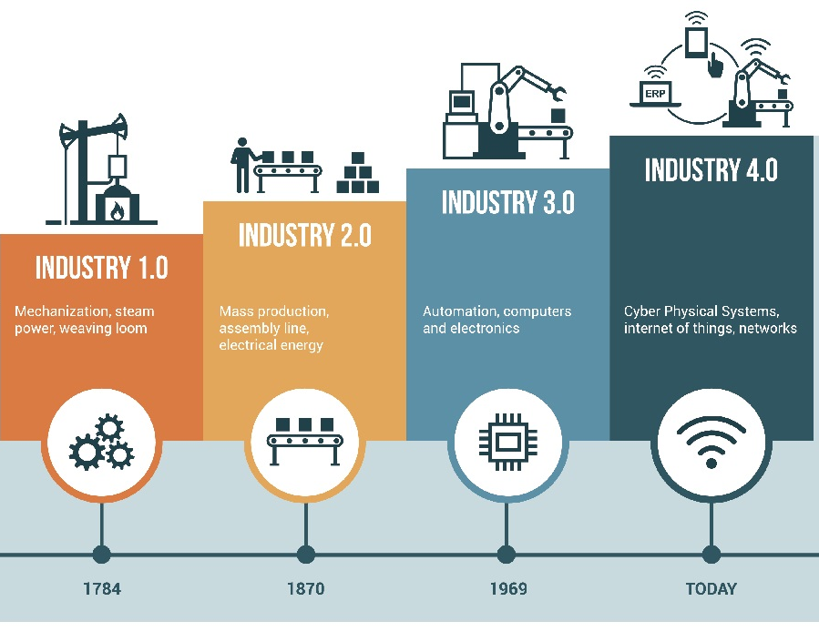
MANUFACTURING IS CHANGING…
It used to take lots of time, resources and manpower to make products
Access to power enabled us to employ machines and produce at scale
Computers allowed human workers to conduct more complex jobs
Today, connected systems allow us to produce products cheaper, faster and at greater scale
Notes:
https://www.google.com/url?sa=i&url=https%3A%2F%2Fwww.aberdeen.com%2Fopspro-essentials%2Findustry-4-0-industrial-iot-manufacturing-sneak-peek%2F&psig=AOvVaw1CJtrKC-rfWX4R0NfqKNV7&ust=158775014729600 0&source=images&cd=vfe&ved=0CAIQjRxqFwoTCNChiraM_-gCFQAAAAAdAAAAABAO

Slide 14
THINK AHEAD…
WHAT WILL MANUFACTURING LOOK LIKE IN 50 YEARS?

